Slide 1
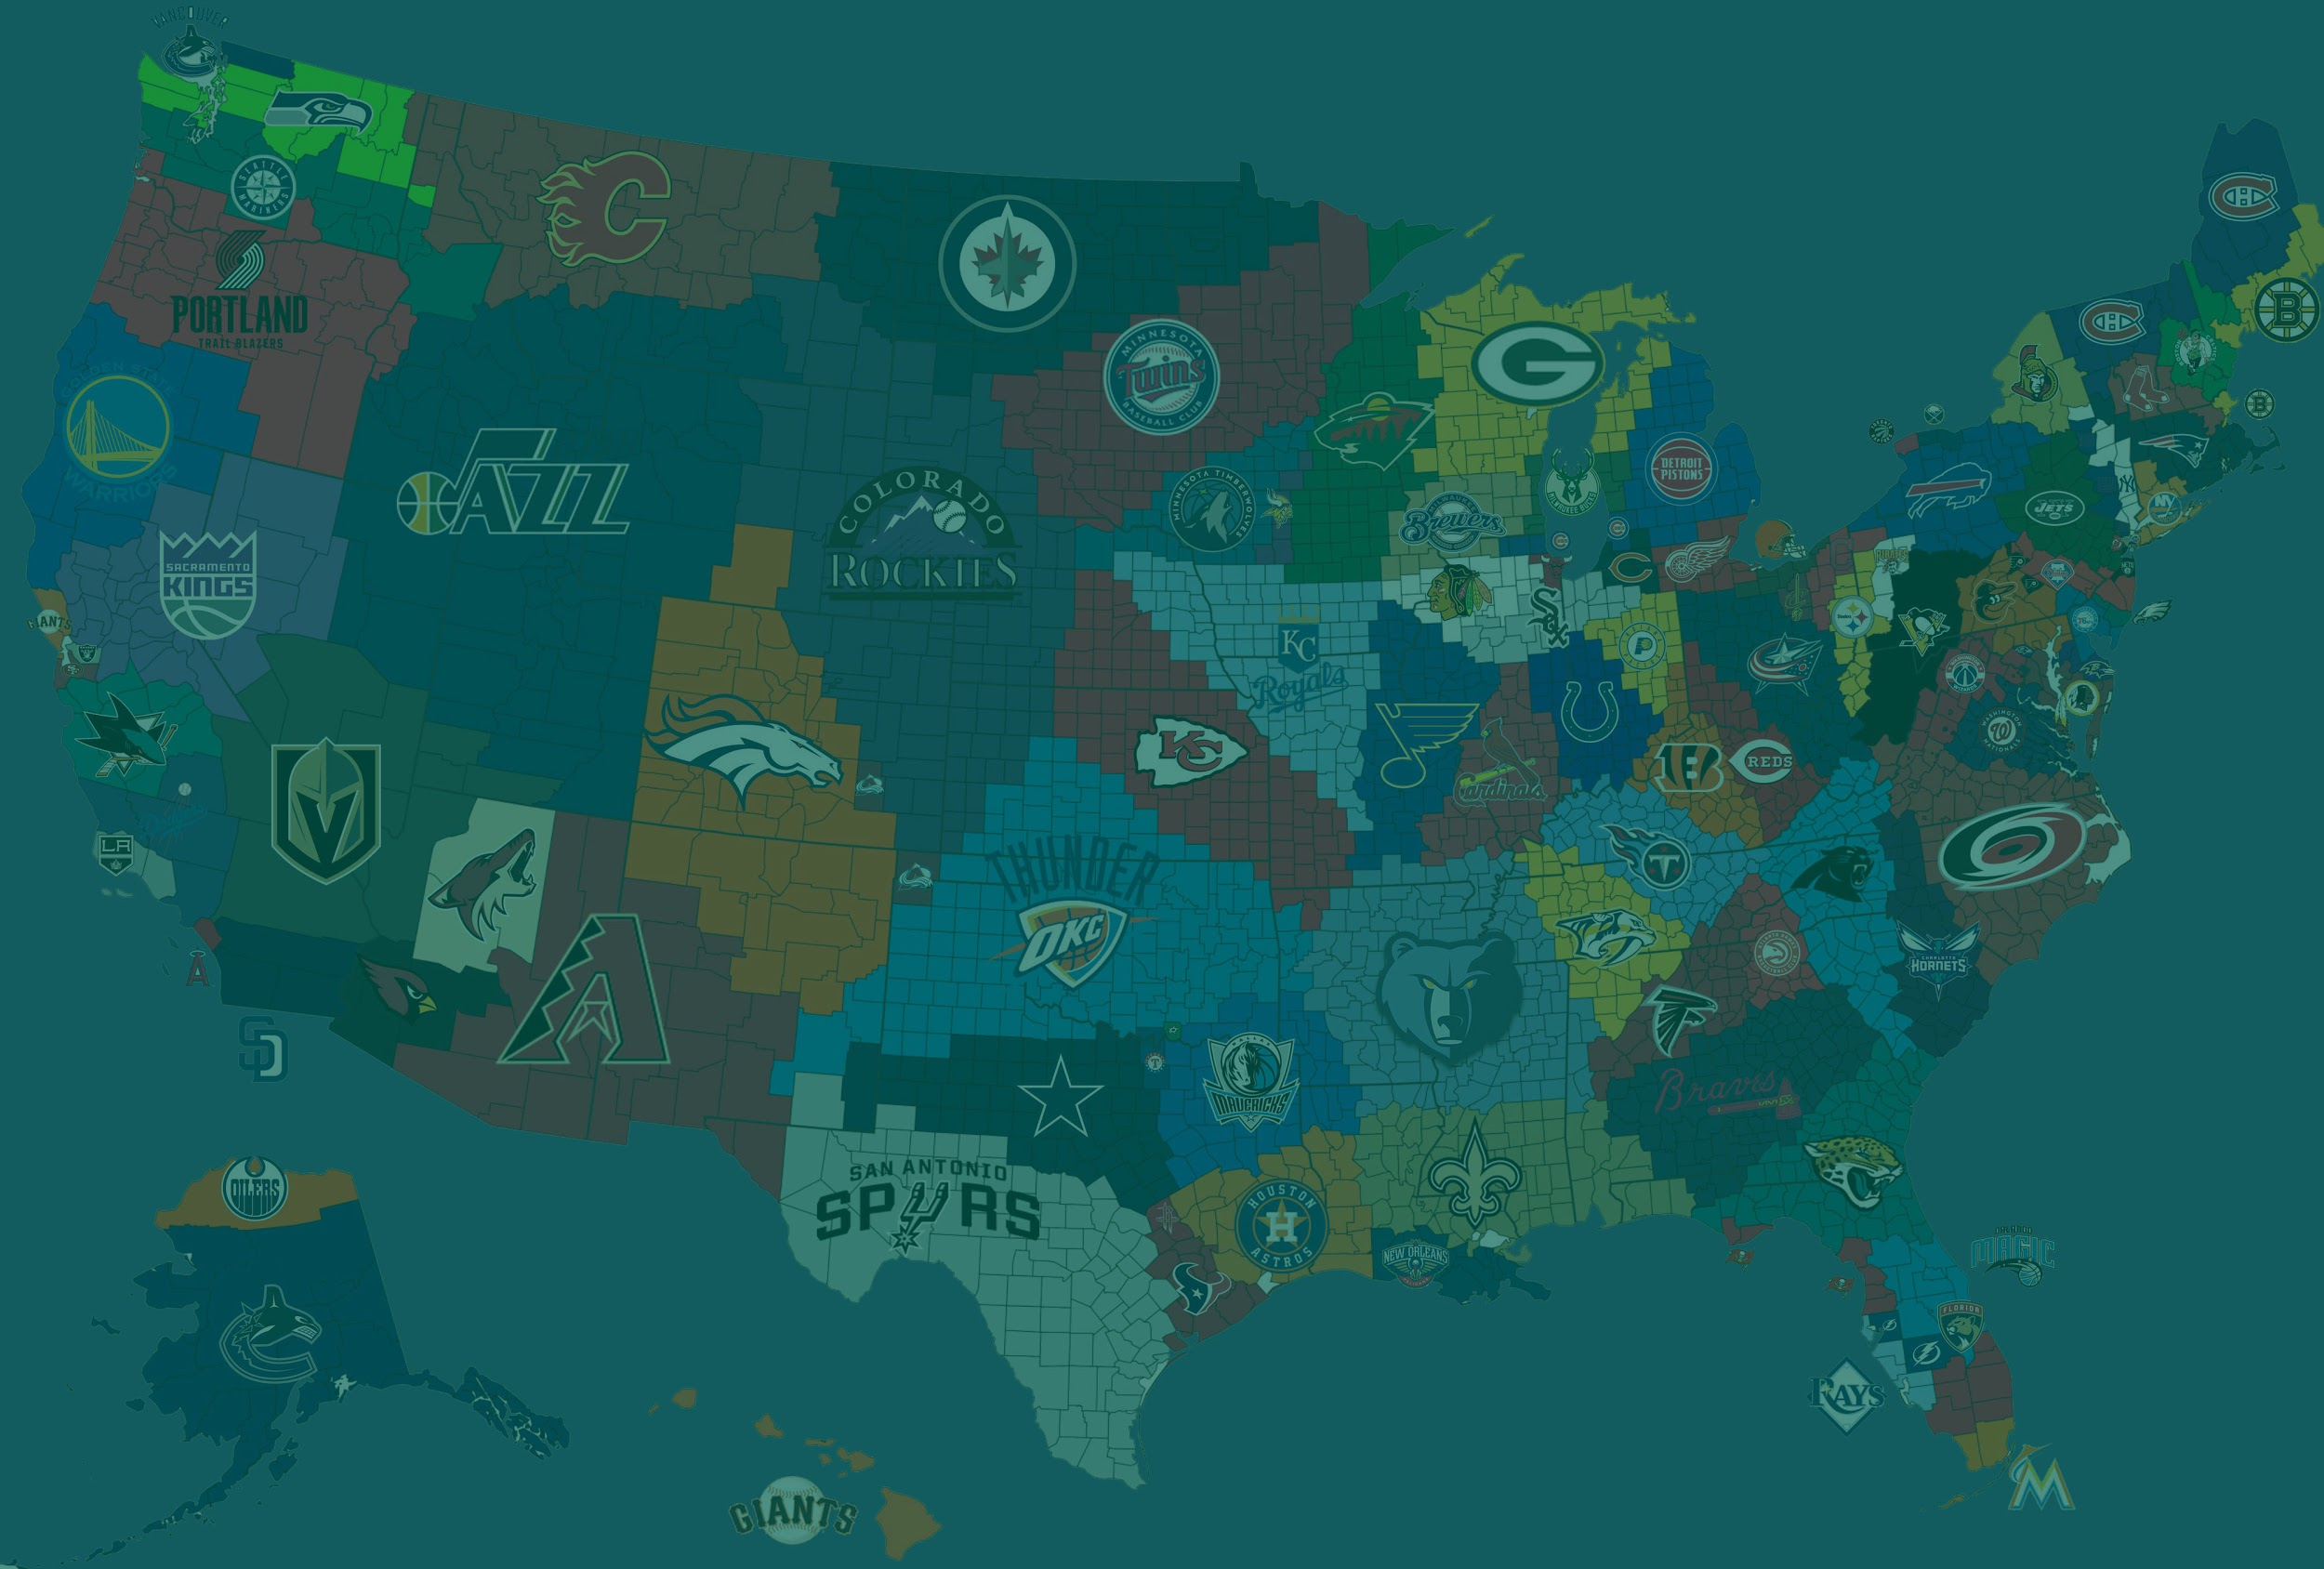
The Playbook:
Mapping out a Multi Billion-Dollar Industry
David Holowitz
Zhong Yu Liu
Kevin Ng

Slide 2

Project Description
Provide viable options for franchise relocation and expansion for the four major North American sports leagues: (MLB, NBA, NFL, NHL)

Slide 3




Key Factors for Expansion or Relocation
When looking at expansion or relocations of franchises, we believe that the key factors are:
Population
Number of Venues
Preexistence of other teams
Employment Rates

Slide 4






Resources Used
Resources Used
-Google API
-ESPN Database
-US Department of Labor Database
-United States Census Bureau Database
-Canadian Census Dataset
-US Department of Homeland Security(Major Sports Venue Database)

Slide 5
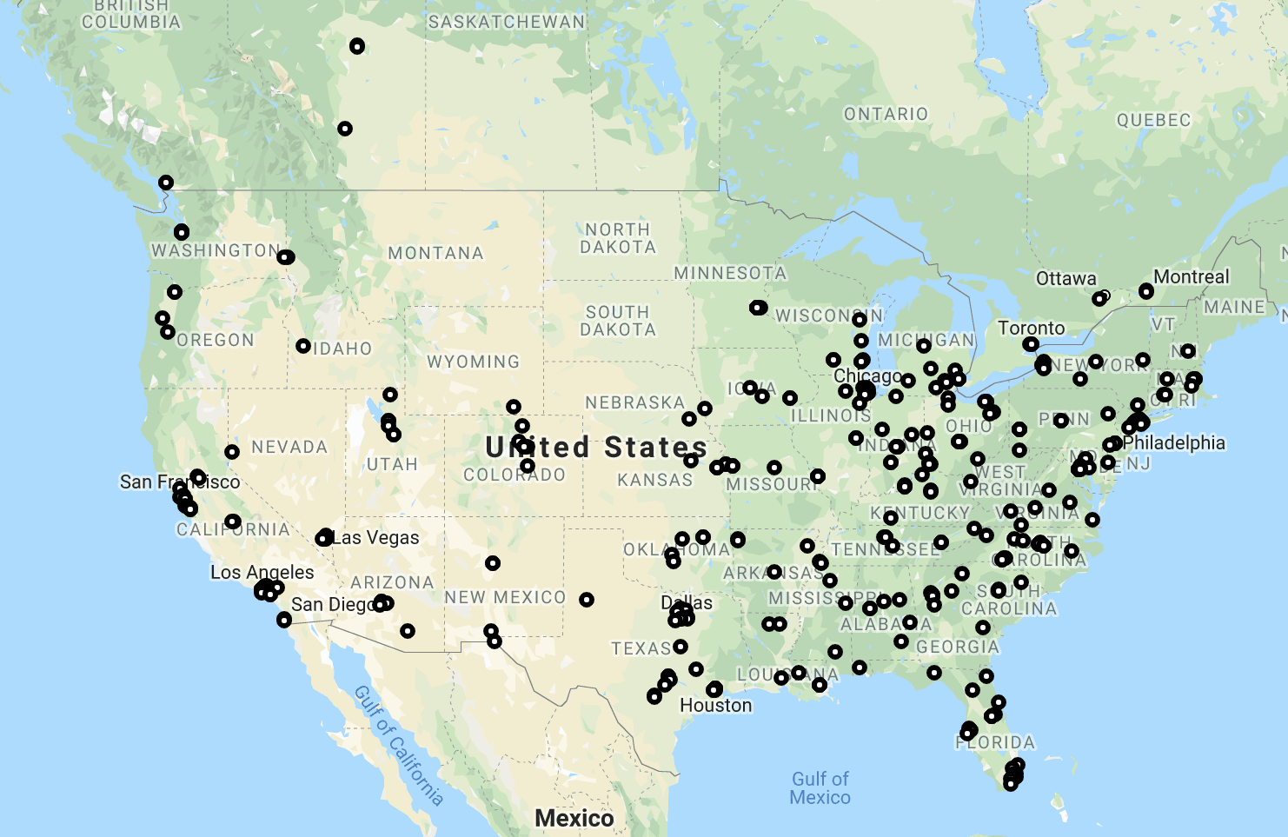
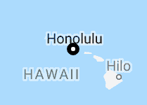
Current Venues

Slide 6
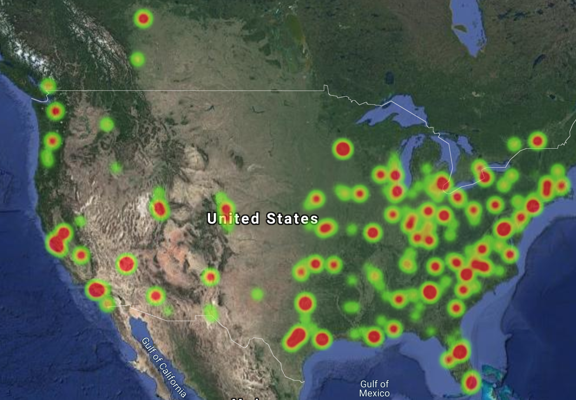

Breakdown
Of Venue Capacity
Notes:
209 venues with 15,000-50,000 capacity: Green
102 venues with 50,001-100,000 capacity: Yellow
14 venues with 100,000 to 260,000 capacity: Red

Slide 7
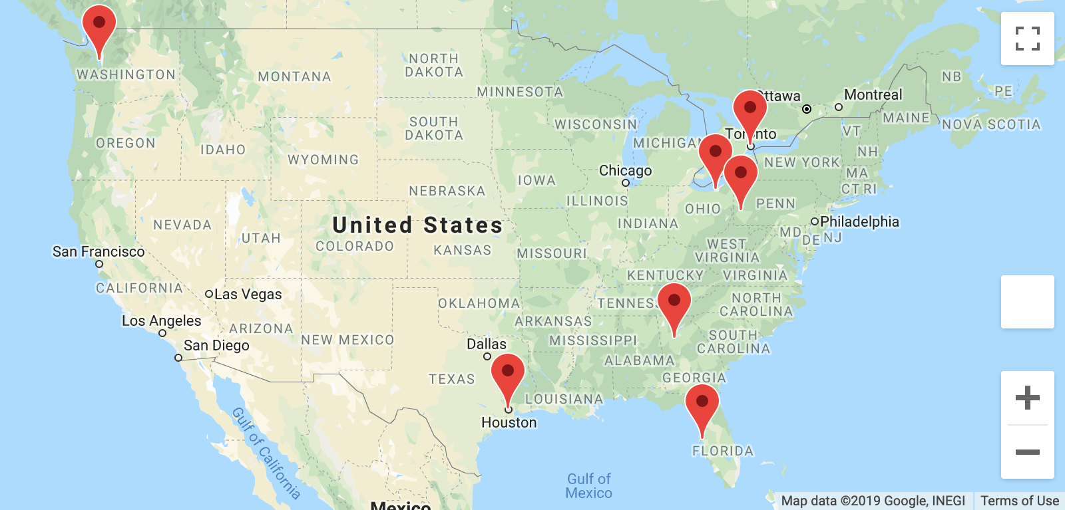
Viable Locations
Houston
Seattle
Atlanta
Tampa
Toronto
Cleveland
Pittsburgh

Slide 8
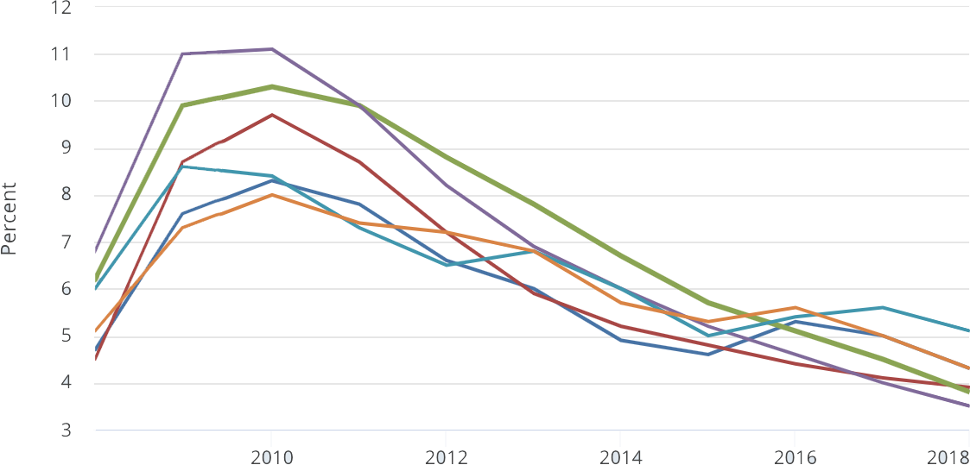
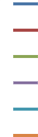
Unemployment Rates in Target Cities
Houston
Seattle
Atlanta
Tampa
Cleveland
Pittsburgh

Slide 9
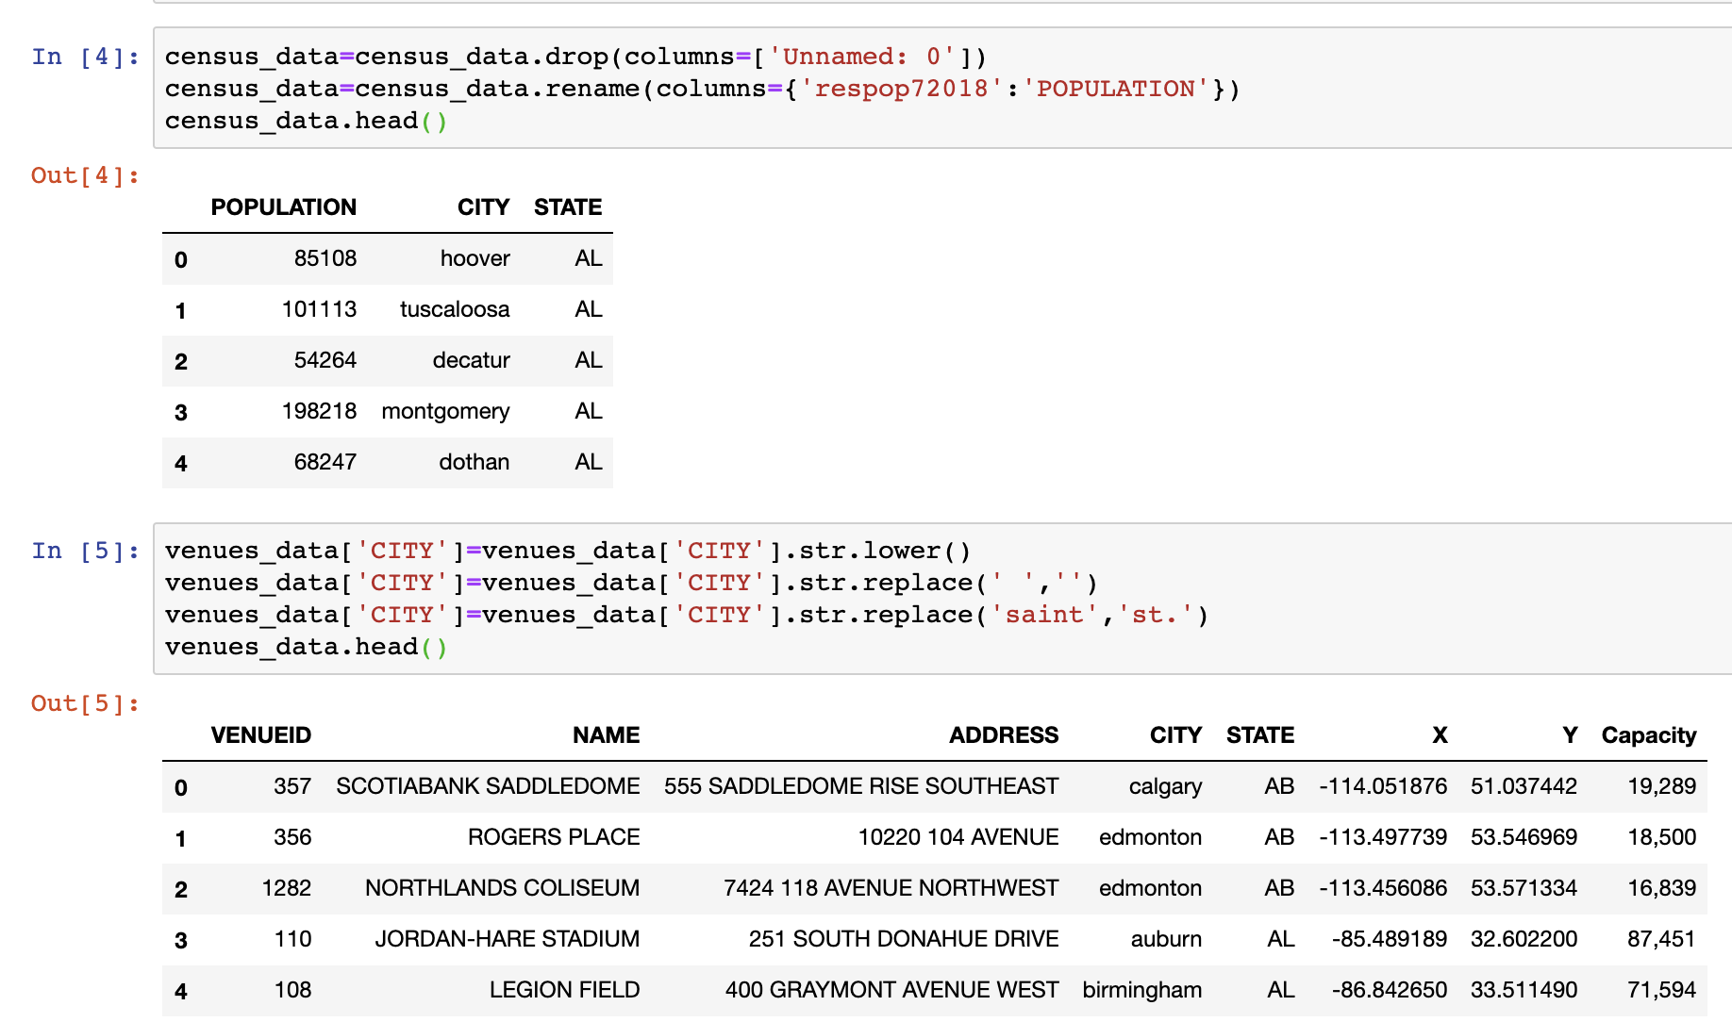
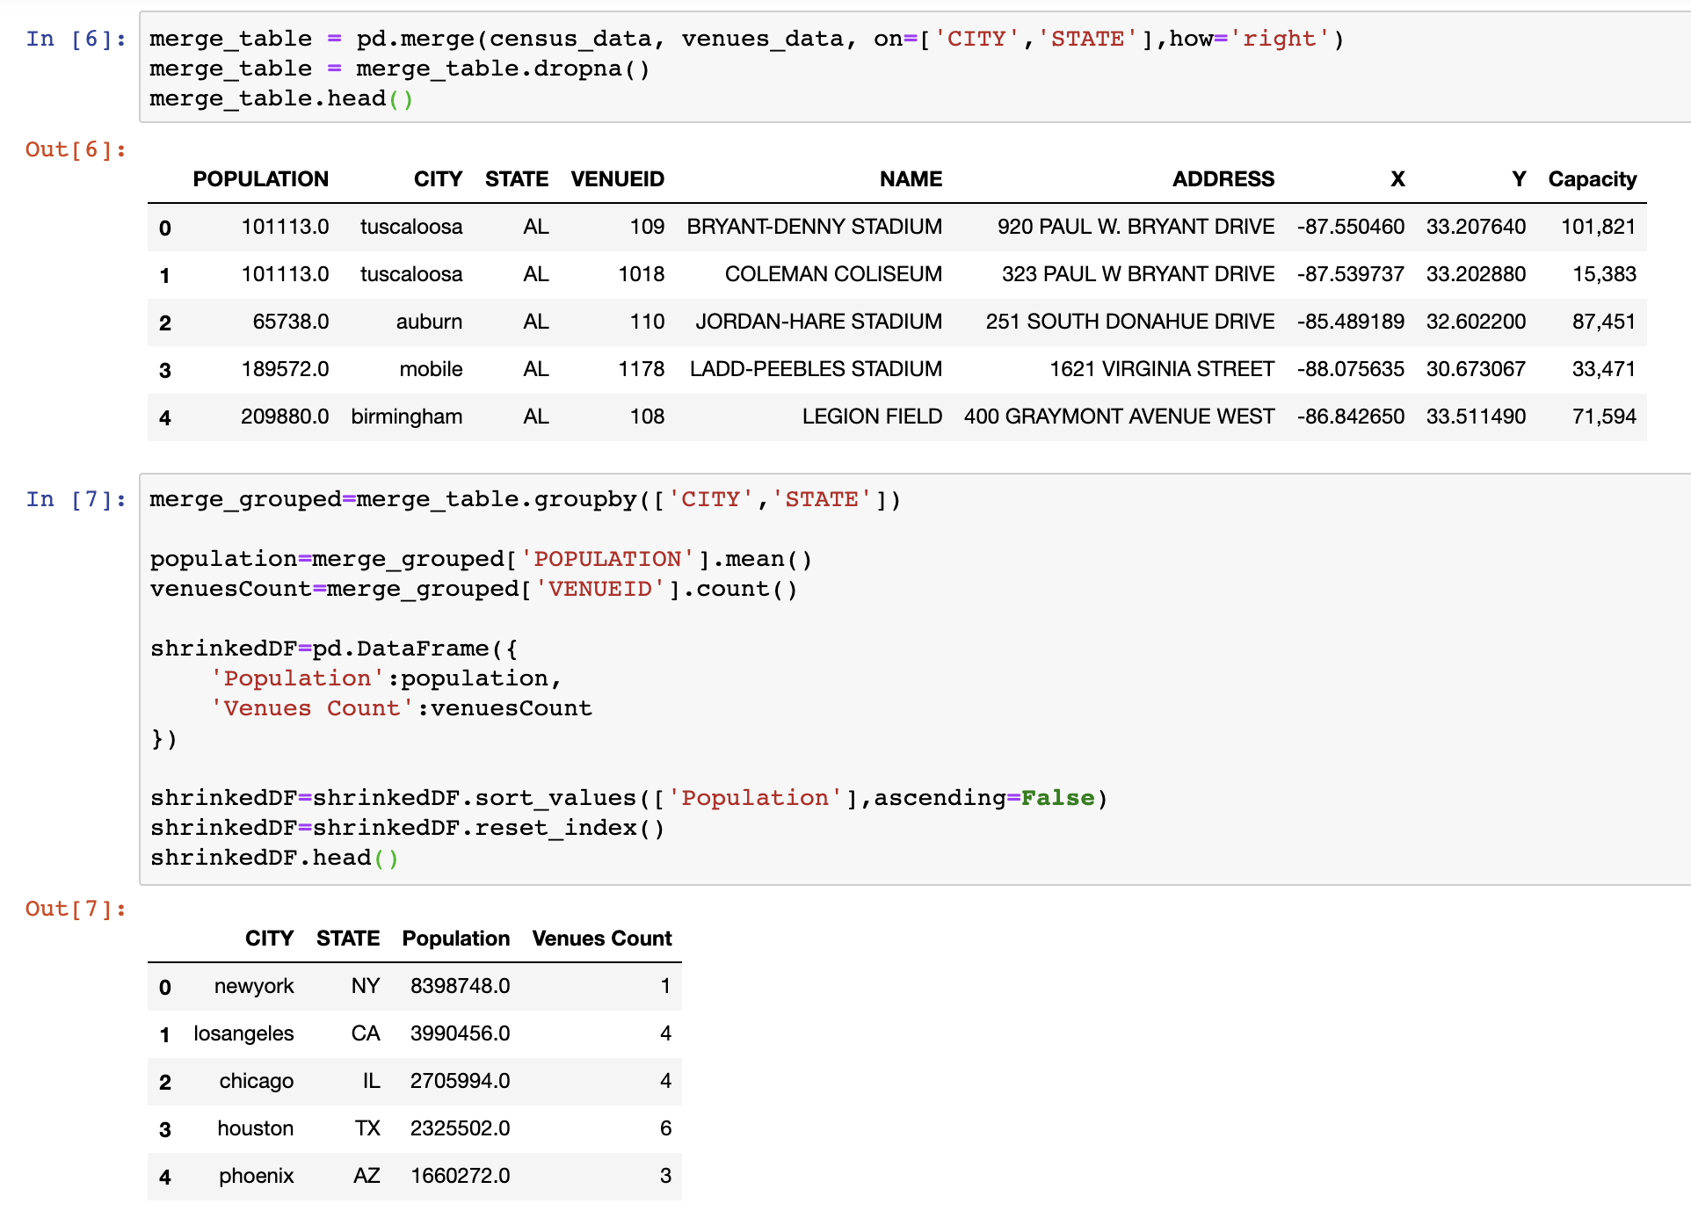
Cleaning the Data

Slide 10
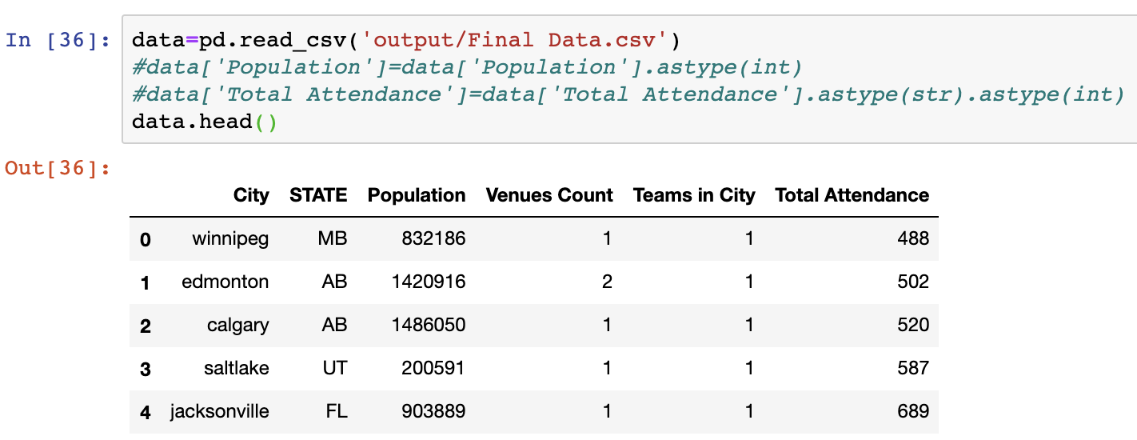
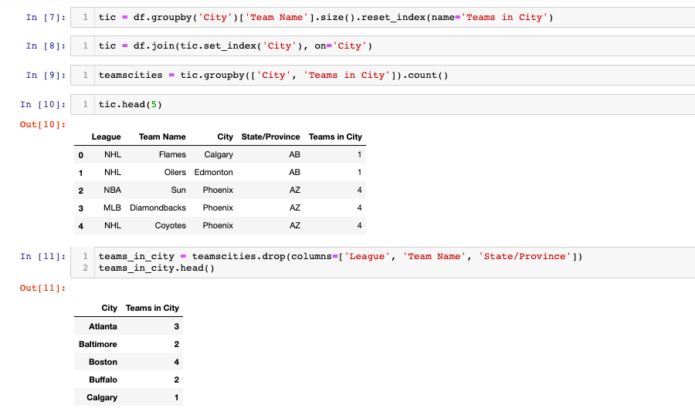
Cleaned and Merged Data

Slide 11
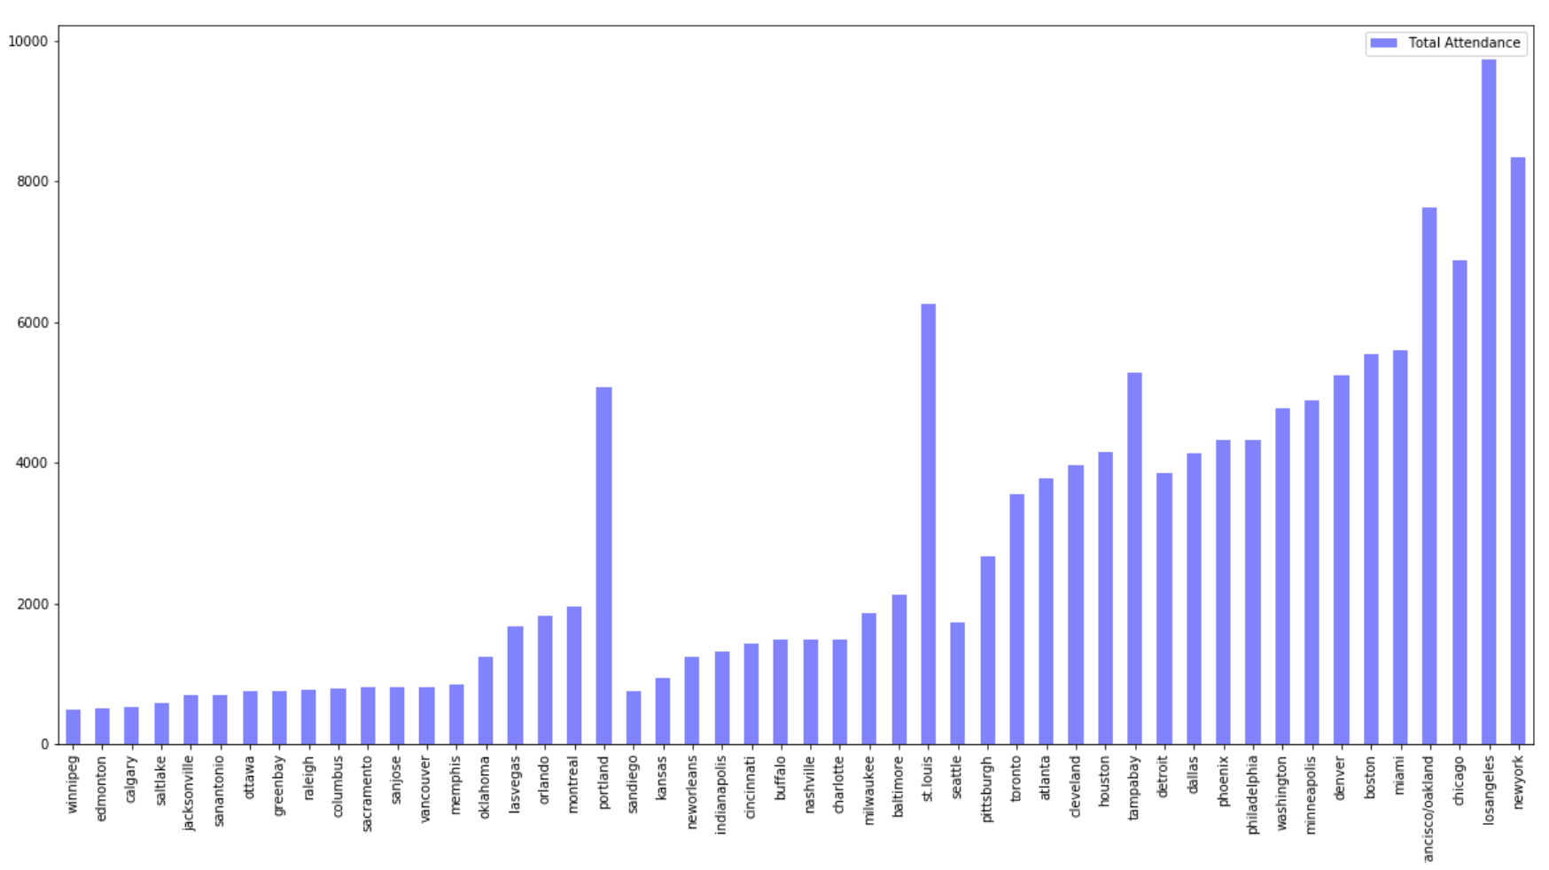
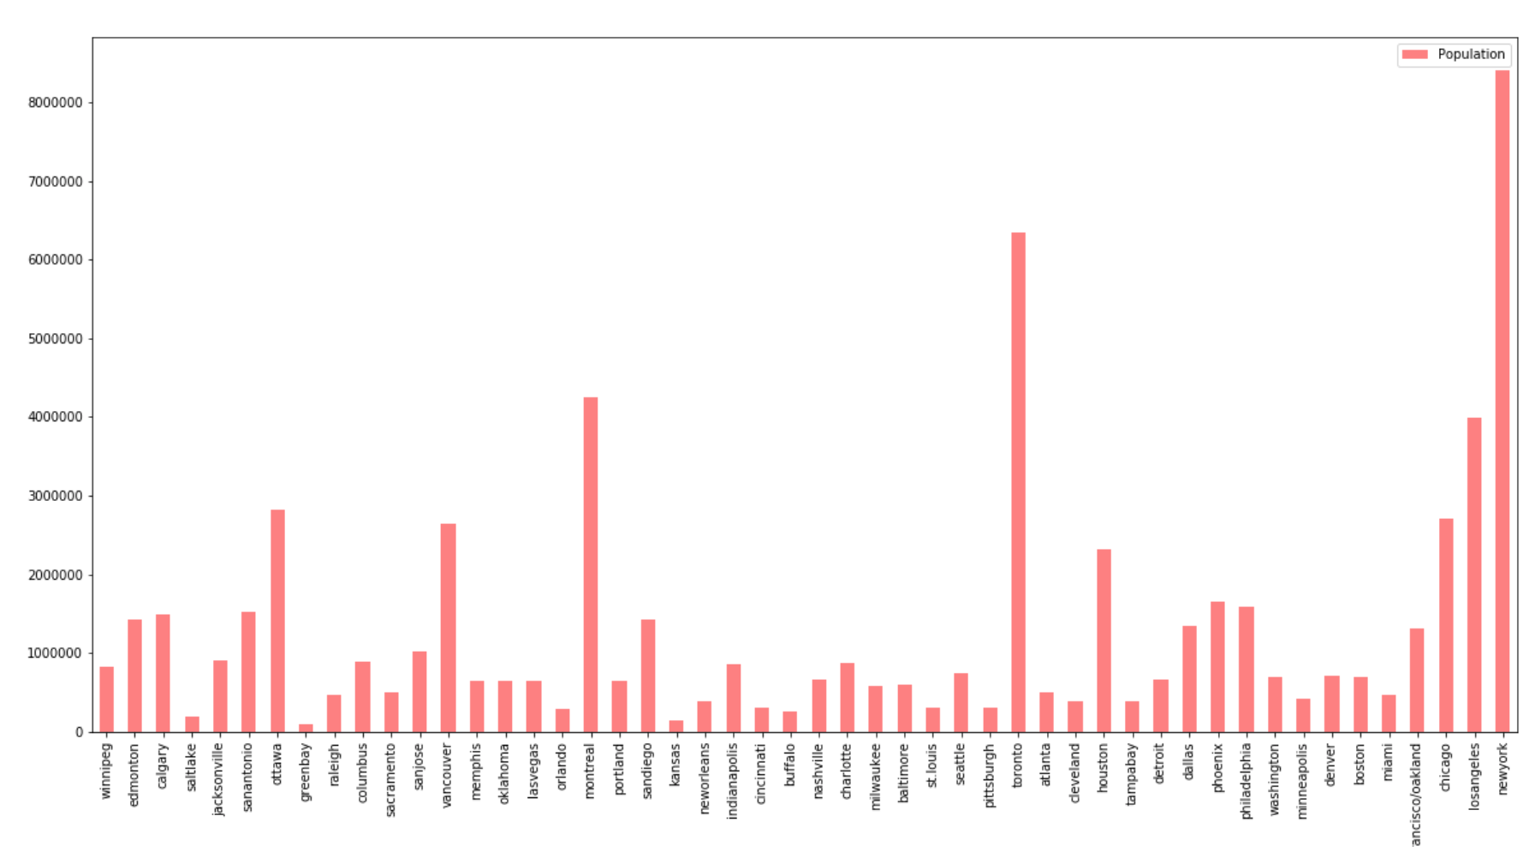
Population of Cities with Sports Franchises

Slide 12
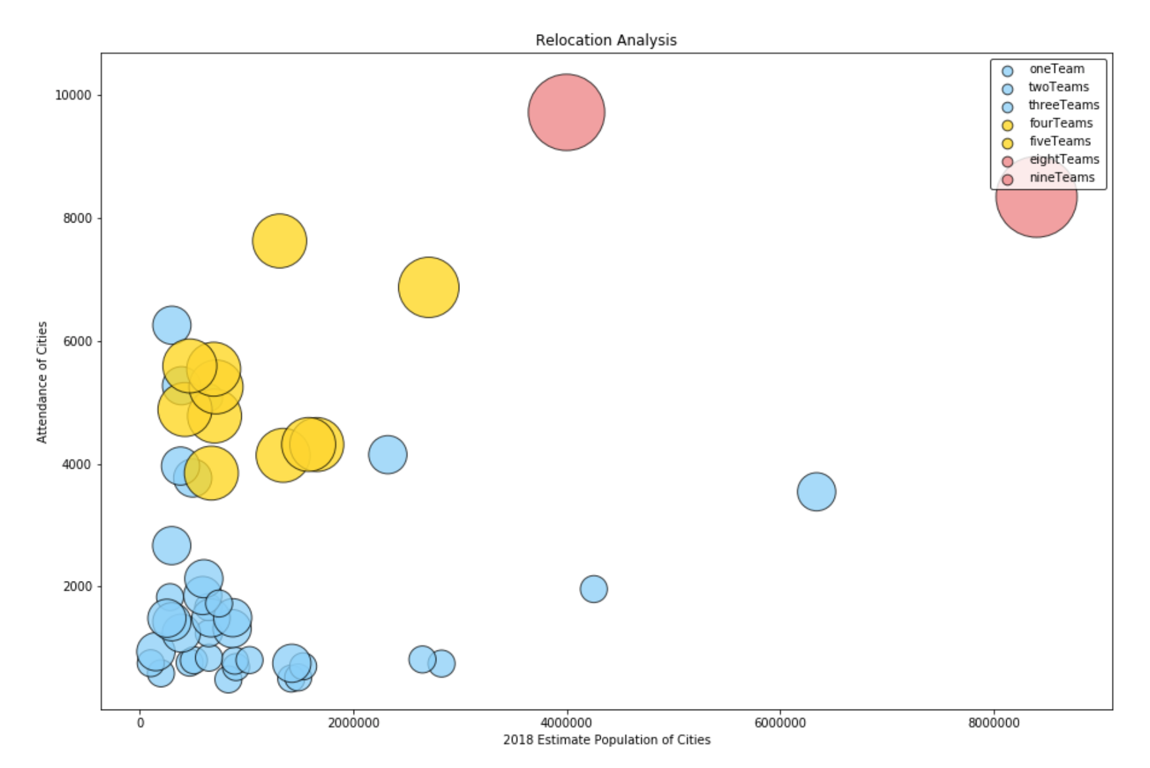
Analysis of Fan Support in Cities

Slide 13
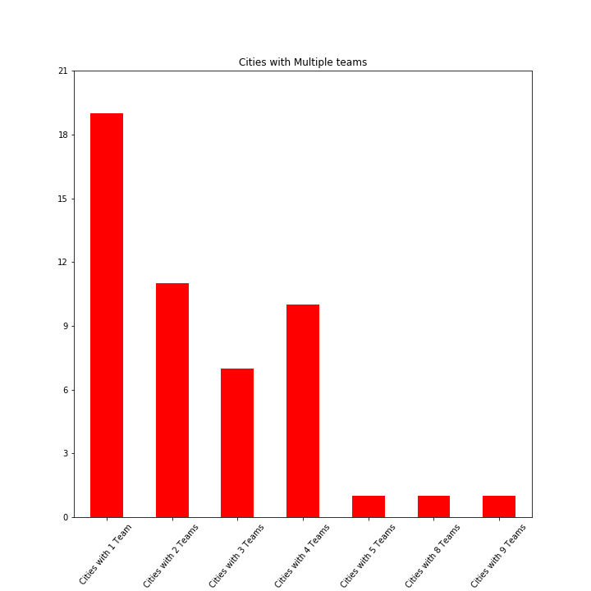
Cities With Multiple Franchises

Slide 14
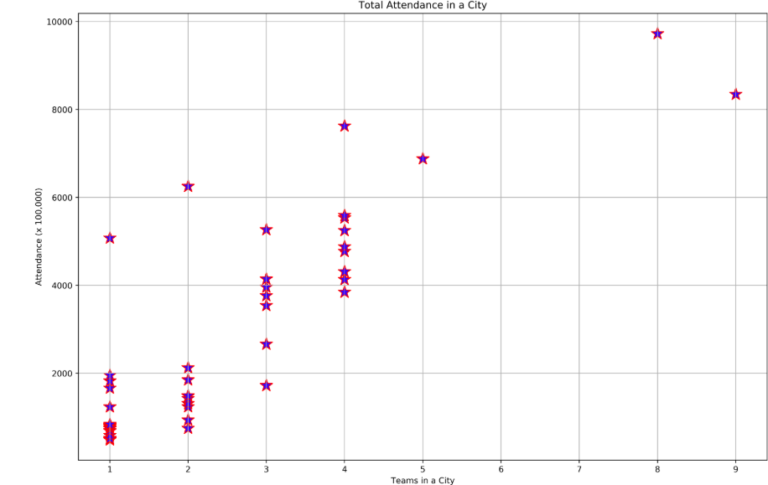
Looking at Attendance Statistics

Slide 15
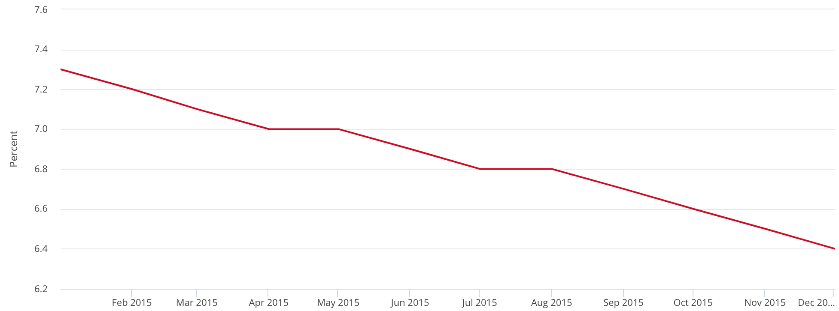
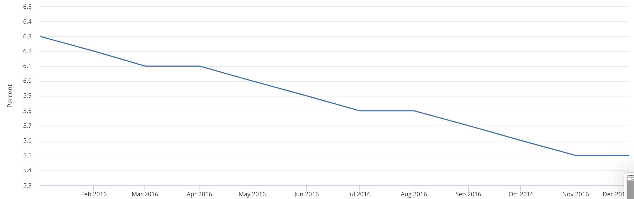
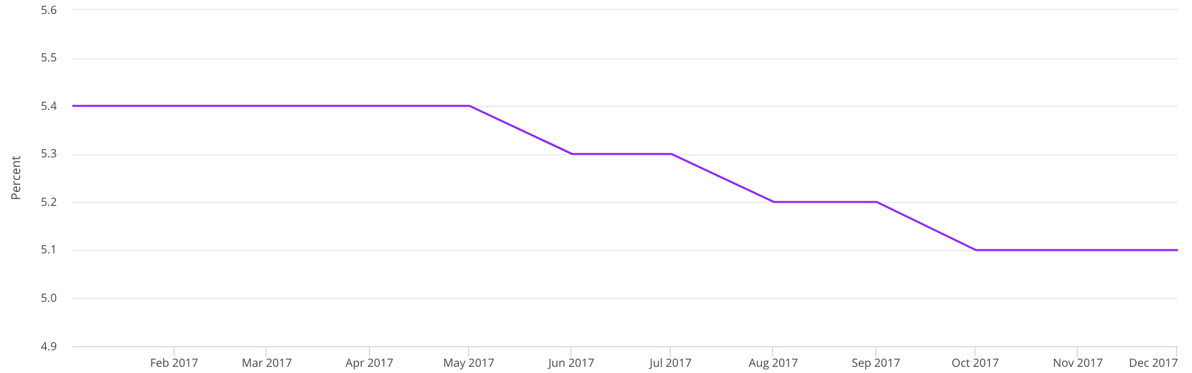

Test Case: Las Vegas
-2016
-2017
-2018

Slide 16

Conclusions
And Limitations

Slide 17
Conclusions
Portland
Tampa
St. Louis
Houston
San Francisco
Oakland
Based on our observations it was clear that these cities were outliers
By being outliers these cities appear to be best suited for a new team
These cities each showed that when compared to cities with other similar factors these in particular had high attendance numbers
We were specifically looking at cities as compared to other cities with the same current amount of teams
Specific conclusions
St. Louis had greatest difference in attendance numbers as compared to other cities with only 2 teams in the city
San Francisco/Oakland was combined due to their close proximity to one another and are covered by the same metropolitan area. Combining these cities into one Metropolitan area contributed to this skew
Houston is included because although it’s attendance records are not as clear of an outlier as Tampa (another city with 3 teams) because it is also had one of the highest venue counts
The fact that there is more viable and available venues that already exist in a city where the attendance numbers are still a positive outlier adds Houston what we can consider a viable location

Slide 18
Conclusions
Seattle
Pittsburgh
These cities were negative outliers and should not be considered for future expansion
These cities were shown to have the lowest attendance numbers for cities with 3 teams
Though Seattle will need to be revisited in the future.
This city was counted as a City with 3 teams however, the NHL franchise already awarded to the city has not begun play yet so could not contribute to the attendance records for the city - roadblock/issue

Slide 19
Limitations, Issues and Roadblocks
Sports and their regions
Different regions are inherently more likely to support on sport compared to another
Differences in sports
Football has the least amount of games but also has largest capacity venues
Baseball has the most games and generally have 2nd largest stadiums -
Canada
Because there are teams outside the US, when we were pulling census we needed to find different dataset than just US
When sorting columns in cleaning data we needed to equate a Canadian Province to a US State
Even though based on our hypothesis and the data, places like New York or Los Angeles would have been ideal candidates but we had to factor in that they also already had many more teams than other cities
Ambition
We may have been a little ambitious with looking at four major sports compared to one

